Slide 1
OPERATING SYSTEMS USING LINUX
SCHOOL OF CSA
I SEM MCA
Prof. VINAY G
16/01/25

Slide 2
Course Objectives:
To relate the operation, implementation and performance of modern operating systems, and the relative merits and suitability of each for complex user applications.
Ability to compare, contrast, and evaluate the key trade-offs between multiple approaches to operating system design, and identifies appropriate design choices when solving real-world problems.
To expose the design of the LINUX operating system.
To illustrate various commands of the LINUX OS.
To demonstrate the different types of filters used in LINUX

Slide 3
Syllabus
Unit 1: 13 Hours
Operating System concepts:
Types of Operating Systems, Operating System Components & Services, System calls.
Process Management: Process Concept, Process Scheduling, Threads, CPU Scheduling Criteria, Scheduling algorithm. The Critical Section Problem, Semaphores, Classical problems of synchronization, Monitors.

Slide 4
Syllabus
Unit 2: 13 Hours
Dead locks – system model, Characterization, Dead lock prevention, avoidance and detection, Recovery from dead lock,.
Memory Management: Logical and Physical address space, Swapping, Contiguous allocation, Paging, Segmentation, Segmentation with paging, Virtual memory-Demand paging and its performance, Page replacement algorithms, Allocation of frames, Thrashing.

Slide 5
Syllabus
Unit 3: 13 Hours
Introduction and Interacting with shell and Desktop to Linux: History, salient features, Linux system architecture, Linux command format, Linux internal and external commands, Directory commands, File related commands, Disk related commands.
The Linux Shell Basic command cls, cat, cal, date, calendar, who, printf, tty, sty, uname, passwd, echo, tput, bc, script, spell and ispell, Introduction to Shell Scripting, Shell Scripts, read, Command Line Arguments, Exit Status of a Command,

Slide 6
Syllabus
Unit 4: 13 Hours
Basic Linux Programming:
User vs, kernel node, context of a Process, background processes, Process scheduling commands, Process terminating and examining commands. Types of shell Process, shell script features, shell command line processing, executing a shell script, system and user-defined variables, expr command, read and echo statement, command substitution, escape sequence characters. Conditional Control Structures-if statement, case statement, Looping Control Structure-while, until, for, statements.

Slide 7
Prerequisites
Basic knowledge of Operating System concepts.
Basic hardware and software aspects of computer systems organization.
Knowledge of basic concepts in data structures, programming languages, and computer architecture.
Basic installation procedures of OS.

Slide 8
Downloads
Download Any Linux Distribution using below link
Ex. UBUNTU, CENTOS, FEDORA, KALI
https://www.linux.org/pages/download/

Slide 9
Course Outcomes:
Describe the basic principles adopted in the design of modern operating systems.
Explain the objective and functions of modern operating systems.
Describe how computing resources are used by application software and managed by system software.
Design and implement the concepts of shell programming.

Slide 10
Text Books:
1. Abraham Silberschatz and Peter Baer Galvin, “OPERATING SYSTEM CONCEPTS”, 8th Edition, Pearson Education, 2002.
2. M.G.Venkateshmurthy, “INTRODUCTION TO UNIX & SHELL PROGRAMMING”, First Edition, Pearson Education, 2004.
3. Richard Petersen, “THE COMPLETE REFERENCE LINUX “ sixth Edition Petersen Tata McGraw Hill [chapter 1]
4. Kernighan B W & Robert B, “THE UNIX PROGRAMMING ENVIRONMENT”.

Slide 11
Reference Books:
Harvey M. Deital, “Operating Systems”, Third Edition, Pearson Education, 2004.
William Stallings, Operating Systems, Prentice Hall.
Daniel P. Bovet, Marco Cesati,”Understanding The Linux Kernel(O'Reilly) “
William Bo Rothwell ,”Linux for Developers: Jumpstart Your Linux Programming Skills
Ellen Siever, Stephen Figgins, Robert Love, Arnold Robbins, “Linux in a Nutshell”, O'Reilly Media, 6th Ed., 2009.
Neil Matthew, Richard Stones, Alan Cox, “Beginning Linux Programming”, 3rd Ed., 2004.

Slide 12
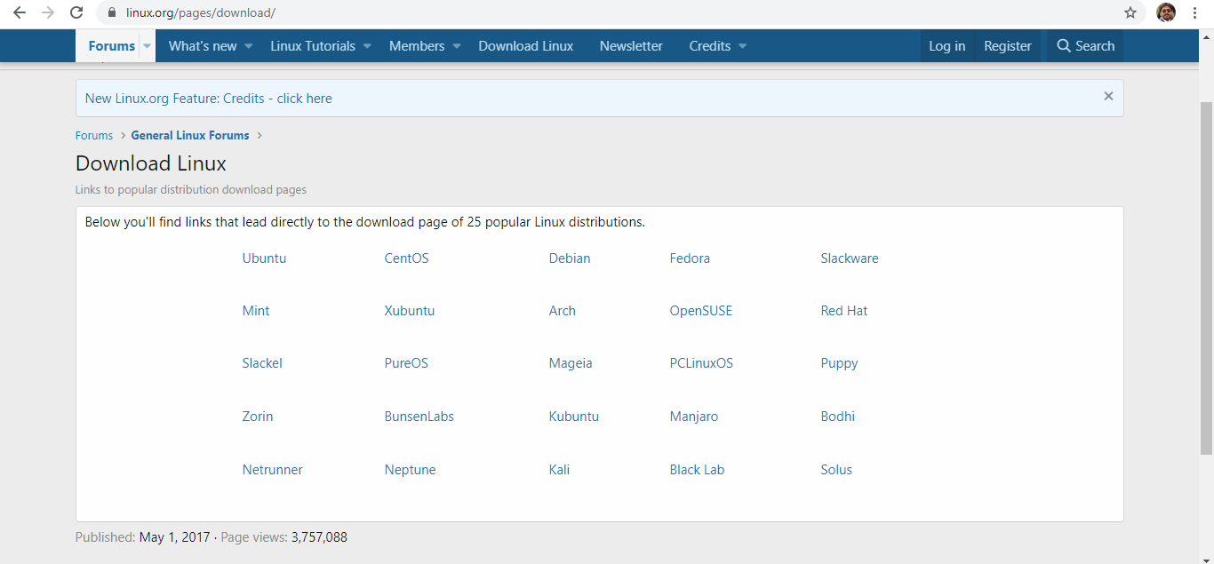

Slide 13

QUESTIONS…?

Slide 14
Exercise Questions
List few operating systems.
Programming Language used to develop those OS.

Slide 15
UNIT -1
OPERATING SYSTEM CONCEPTS

Slide 16
Operating System
A collection of programs which control the resources of a computer system.
An interface between the users and the hardware.
When the computer is on, OS will first load into the main memory.
System software that manages the computer H/W.
OS coordinates the individual components of the computer to make the program execute.

Slide 17
Operating System
Objectives of Operating System
To make the computer system convenient to use in an efficient manner.
To hide the details of the hardware resources from the users.
To provide users a convenient interface to use the computer system.
To act as an intermediary between the hardware and its users, making it easier for the users to access and use other resources.
To manage the resources of a computer system.
To keep track of who is using which resource, granting resource requests, and mediating conflicting requests from different programs and users.

Slide 18
Operating System
Basic functions of the operating system
Memory Management
Processor Management
Device Management
File Management
Security
Control over System Performance
Job Accounting
Error Detecting Aids
Coordination b/w other software and users

Slide 19
Operating System
Other function of Operating System
Best use of the computer resources
Provide a background for user’s programs to execute
Display and deal with errors when it happens
Act as a communication link between users
System protection

Slide 20
Operating System
Architecture of Computer System
Hardware
Operating System (OS)
Programming Language (e.g. PASCAL)
Application Programs (e.g. WORD, EXCEL)

Slide 21
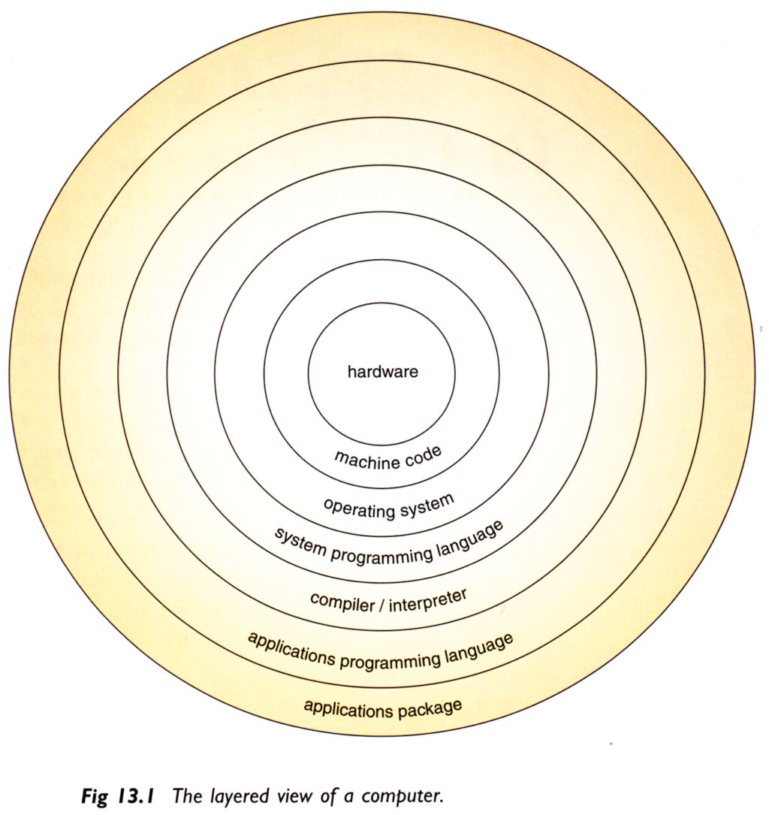
Operating System
Detail Layered View of Computer
CPU,MEMORY

Slide 22
Operating System
System Software, Application Software and
Driver Programs
System Software- Performs essential operation tasks
Operating system
Utility programs
Application Software - Performs specific tasks for users
Business application
Communications application
Multimedia application
Entertainment and educational software
Driver Programs (Device Driver)
small program that allows a specific input or output device to communicate with the rest of the computer system

Slide 23
Operating System
3 type of programs
User / application programs
Programs used by the users to perform a task
System programs
An interface between user and computer
Driver programs
Communicate I/O devices with computer

Slide 24
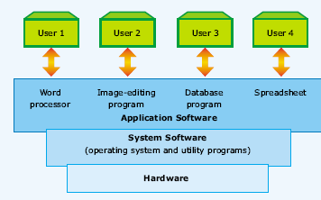
Operating System
Hierarchy of computer software

Slide 25
Operating System
Common Operating Systems and Their Differences
Network Operating System-supports multiple user
UNIX / Linux / MS Windows2000 Server
Desktop Operating System-supports single user
MS Windows 9X/Me / Mac OS / DOS
Mobile Operating System
Palm OS and Pocket PC

Slide 26
Operating System
Examples
Common operating systems
WINDOW
used in IBM compatible microcomputers
UNIX
multi-user, multi-tasking OS used in minicomputers and microcomputers
VAX/VMS
used in DEC’s VAX series of minicomputers

Slide 27
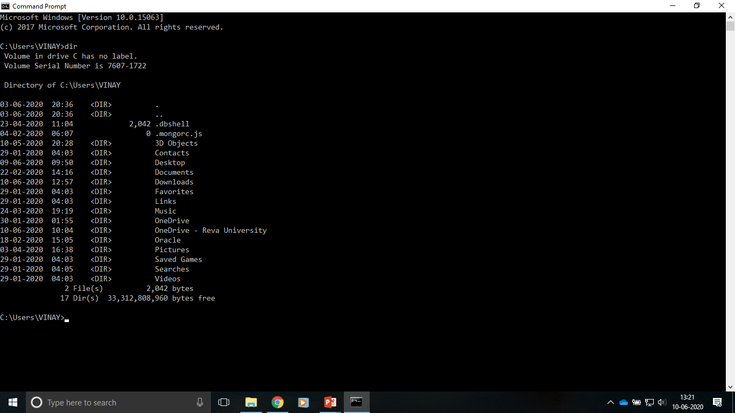
Operating System
DOS interface

Slide 28
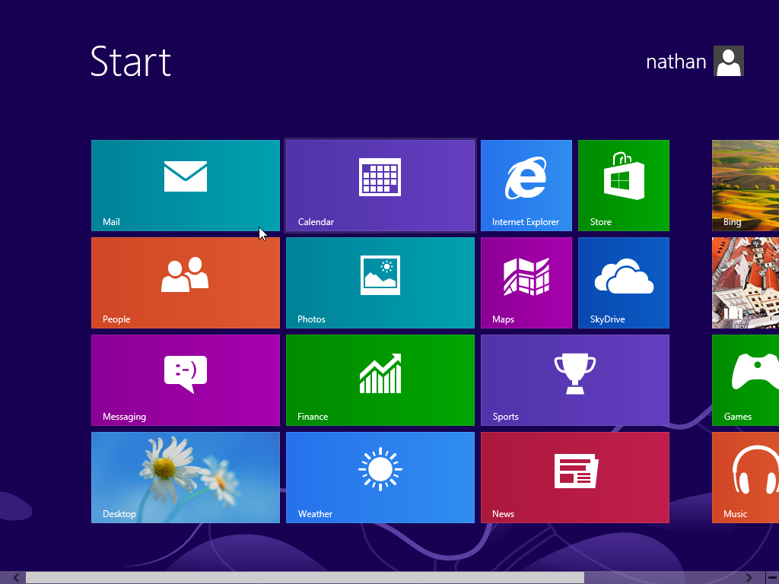
Operating System
GUI

Slide 29
Operating System
Different Types of Operating System
UNIX | DOS | Mac OS | MS Windows | Linux | Palm OS/Pocket PC
Multi-user, multi-tasking | Single-user, Single-tasking | Single- user, multi-tasking | Single- user, multi-tasking | Multi-user, multi-tasking | Single- user, multi-tasking
Command-line user interface | Command-line user interface | GUI | GUI | Command-line user interface, GUI | GUI
UNIX has several versions but they lack interoperability | DOS has been replaced by MS Windows OS | Mac OS has easy-to-use GUI | The first true MS OS is MS Windows 95 | Linux is an open-source software | They are specifically designed for PDA
Network OS | Desktop OS | Desktop OS | Desktop OS | Network OS | Mobile OS

Slide 30
Operating System
Types of Operating System
Batch processing
Multiprogramming
Time sharing
Parallel
Distributed
Real time systems

Slide 31
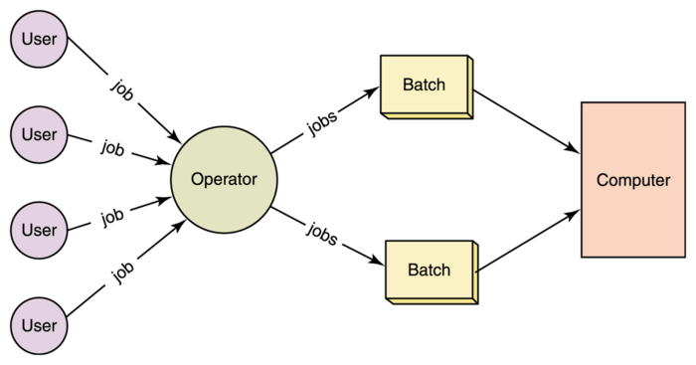
Operating System
Batch processing

Slide 32
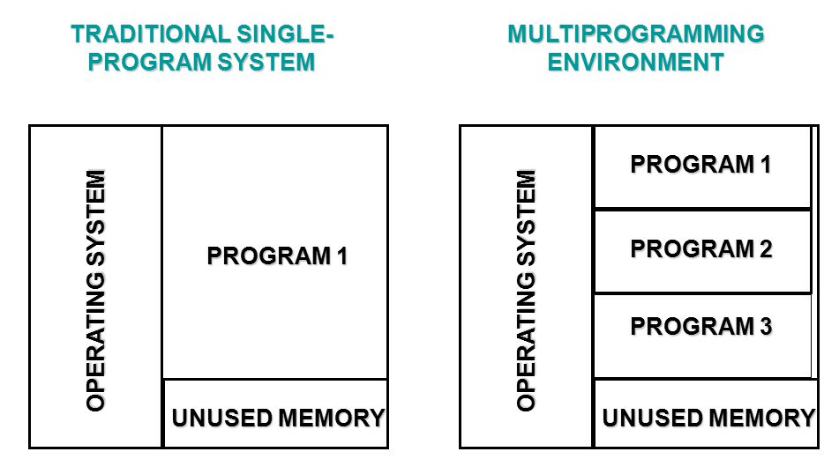
Operating System
Multiprogramming

Slide 33
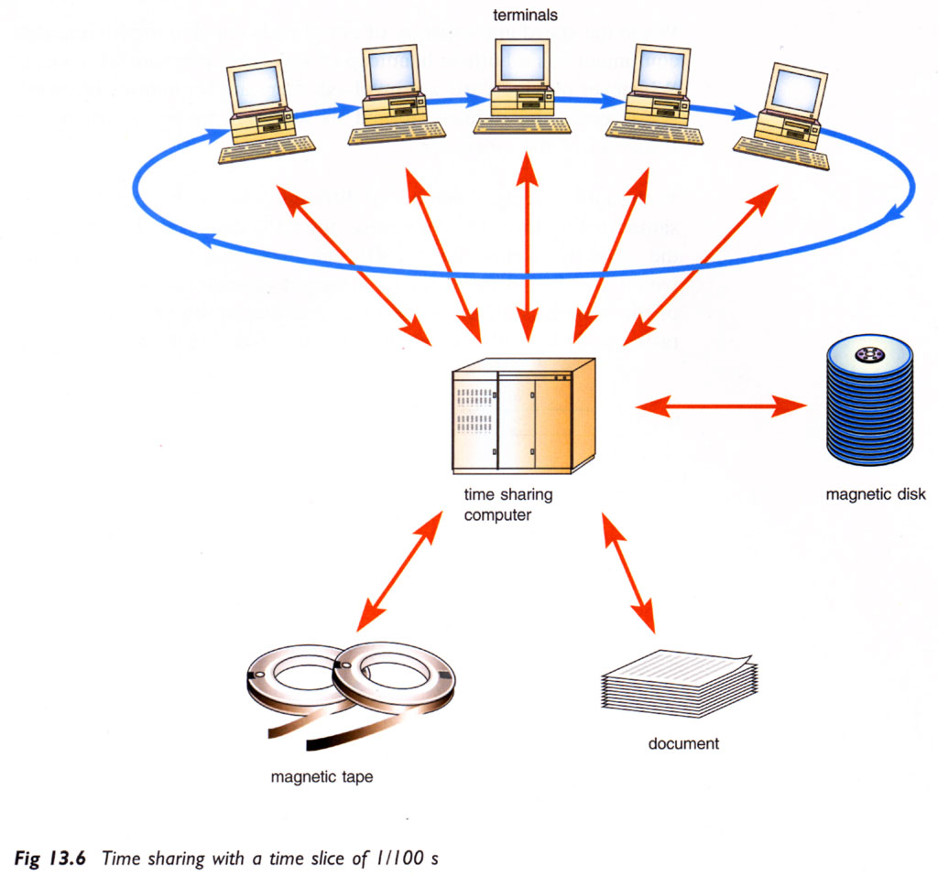
Operating System
Time sharing Processing

Slide 34
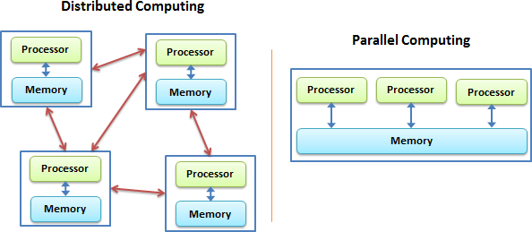
Operating System
Parallel Processing

Slide 35
Operating System
Distributed Systems

Slide 36
Operating System
Special Features of OS
Multi-tasking
Multi-programming
Parallel processing
Buffering
Spooling

Slide 37
OS Structures
Structures of operating systems tend to differ depending on :
The arrangement of files
How hardware and applications are installed and controlled and
How the user interacts with the system.

Slide 38
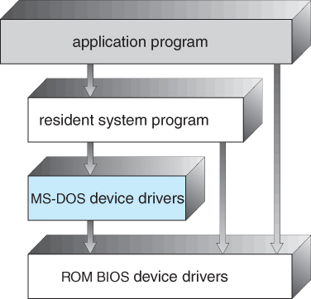
OS Structures
1. Simple Structure
MS DOS has the simplest structure.
MS-DOS operating systems are divided into a number of layers; build one on top of the other.

Slide 39
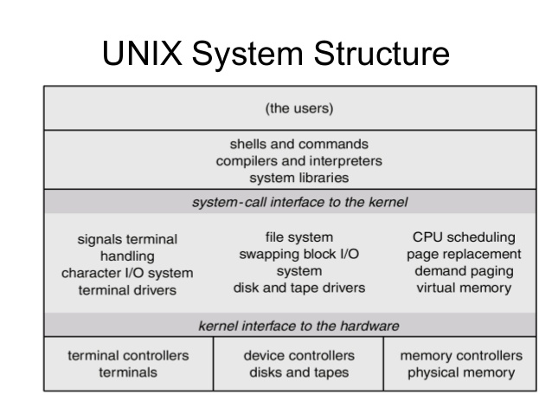
OS Structures
2. Layered Approach
A system can be made modular in many ways. One method is the layered approach, in which the operating system is broken up into a number of layers (levels).

Slide 40
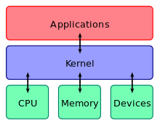
OS Structures
Kernel
The different tasks performed by a kernel includes:
Program Execution
Interrupts
Modes
Memory management
A kernel connects the application software to the hardware of a computer.

Slide 41
OS Structures
3. Microkernels
user processes
user mode
file system
high-level scheduling
system processes
thread system
external paging
network support
communication
microkernel
low-level VM
processor control
kernel mode
protection
hardware

Slide 42
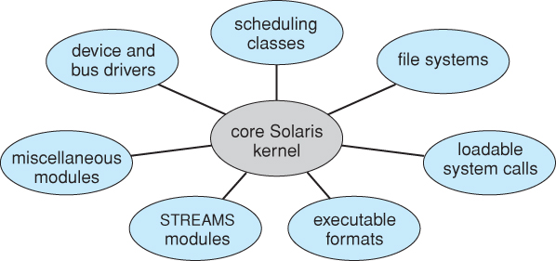
OS Structures
4. Modules
The OS design involves using object-oriented programming techniques to create a modular kernel.

Slide 43
OS Components
The components of an operating system all exist in order to make the different parts of a computer work together. The OS consists of the following 4 components :
Kernel
Networking
Security
User Interface.

Slide 44
OS Components
Kernel
A kernel connects the application software to the hardware of a computer.

Slide 45
OS COMPONENTS
Kernel
The different tasks performed by a kernel includes:
Program Execution
Interrupts
Modes
Memory management
Multitasking
Disk access and file systems
Device drivers

Slide 46
OS COMPONENTS
2. Networking
The computers running dissimilar operating systems can participate in a common network for sharing resources such as computing, files, printers, and scanners using either wired or wireless connections.

Slide 47
OS COMPONENTS
3. Security
The operating system must be capable of distinguishing between requests which should be allowed to be processed, and others which should not be processed.

Slide 48
OS COMPONENTS
4. User Interface
Every computer that is to be operated by an individual requires a user interface.
The two most common forms of a user interface have been :
Command Line Interface
Graphical User Interface

Slide 49
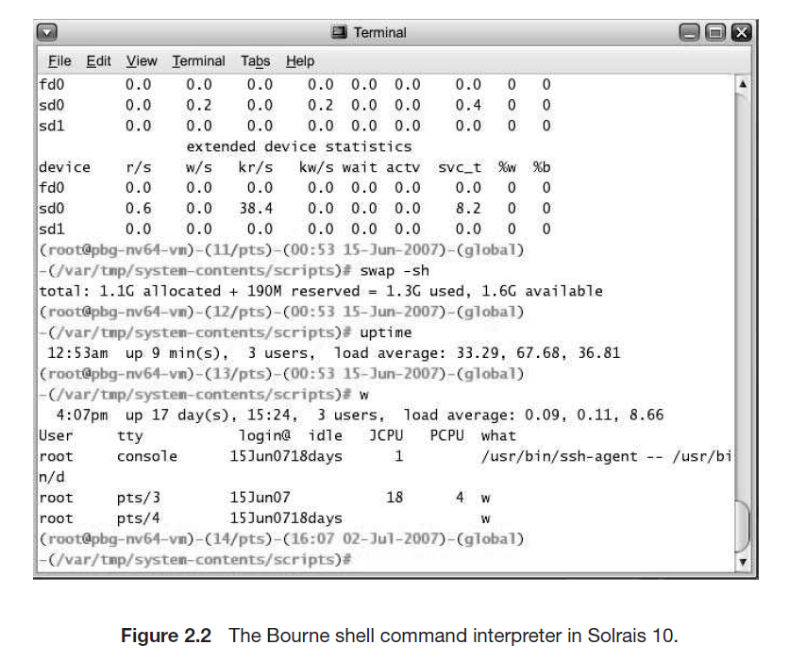
OS COMPONENTS
Command Line Interface

Slide 50
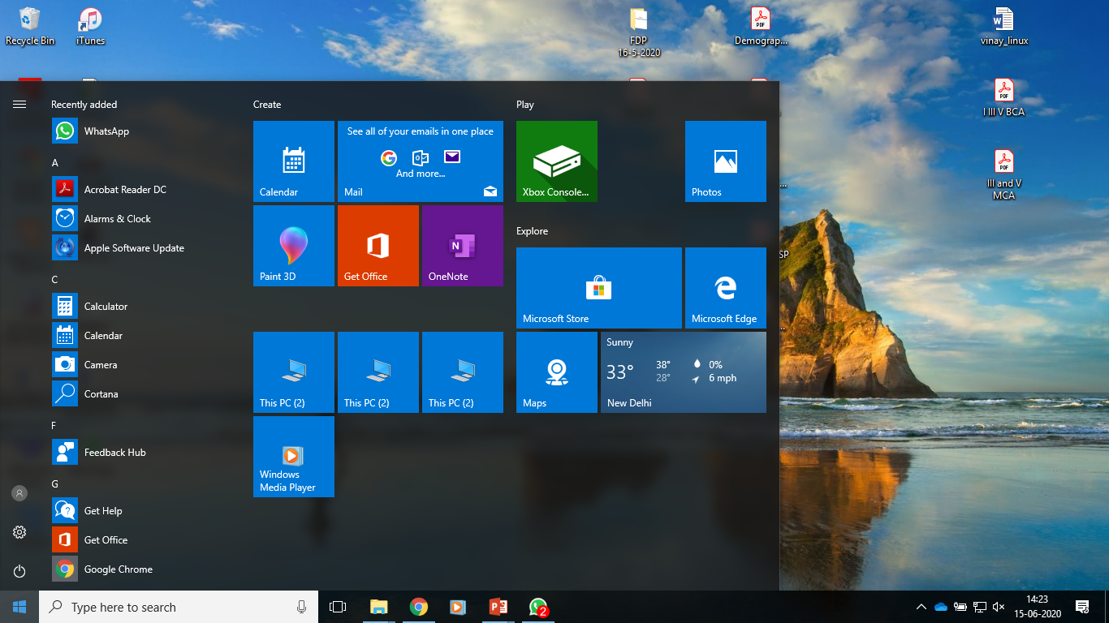
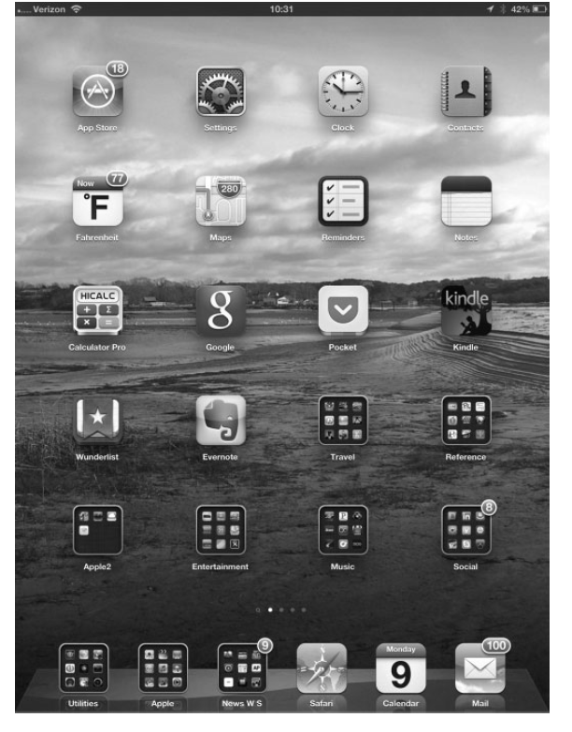
OS COMPONENTS
2. Graphical User Interface

Slide 51
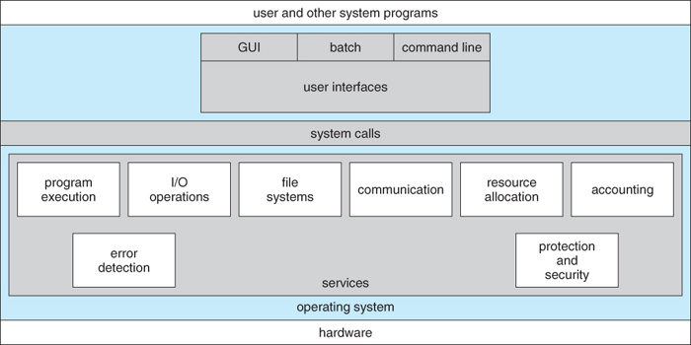
OS SERVICES
OS provides certain services to programs and to the users of those programs.
Services make programming easy and convenient for user
Fig : OS Services

Slide 52
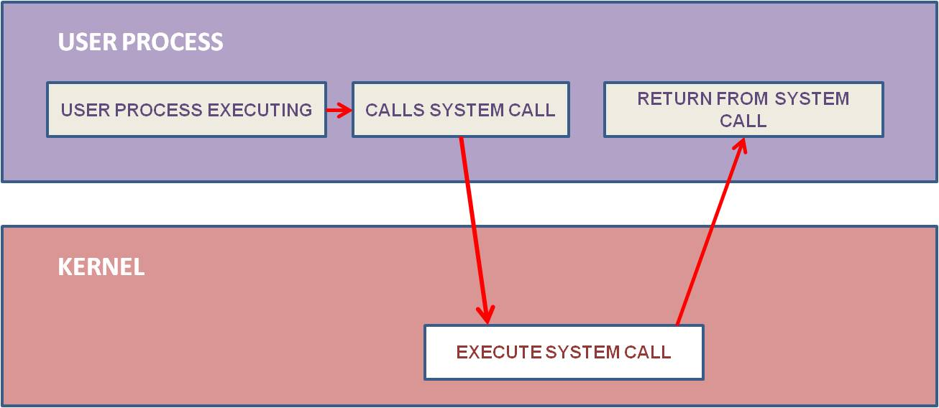
SYSTEM CALLS
The interface between a process and an operating system is provided by system calls.
System calls are usually made when a process in user mode requires access to a resource.
Many high level language such as C,C++ allow system call to made directly.
Fig : System Call

Slide 53
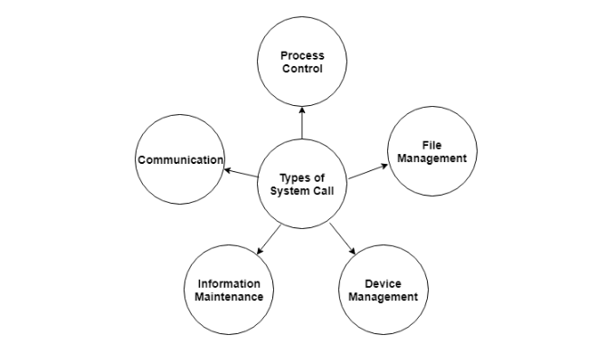
SYSTEM CALLS
Types of System Calls
There are mainly five types of system calls. These are explained in detail as follows.
Services provided by OS is made available to user.

Slide 54
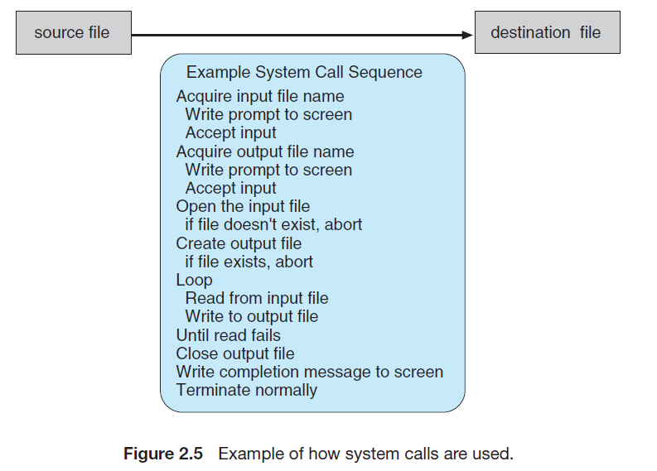
SYSTEM CALLS
Example:

Slide 55
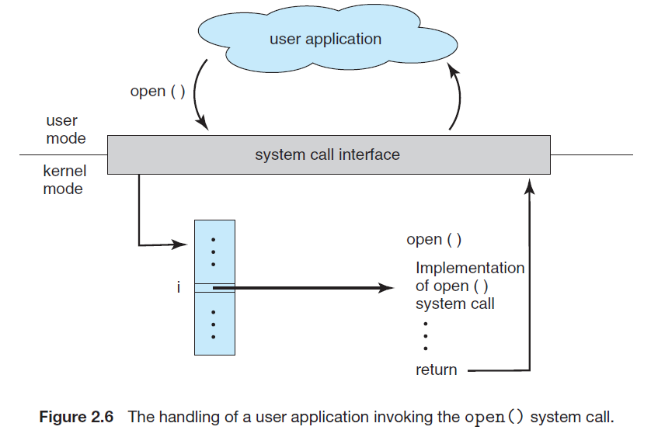
SYSTEM CALLS
Example:

Slide 56
SYSTEM CALLS
Types of System Calls:
System calls can be grouped roughly into five major categories:
Process control
File Management
Device Management
Information Maintenance
Communications.

Slide 57
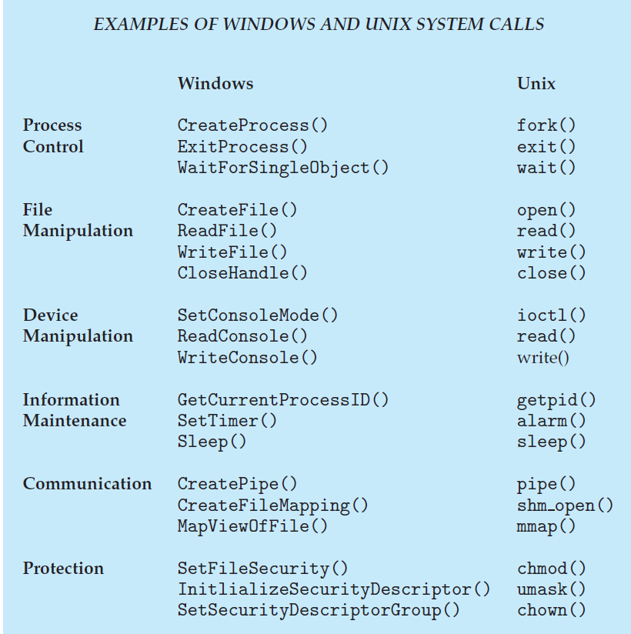
SYSTEM CALLS

Slide 58
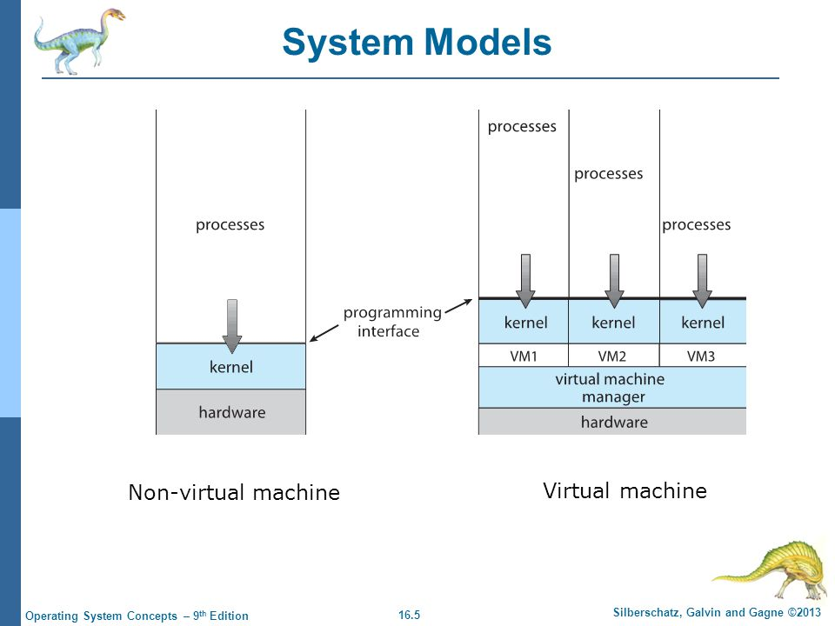
VIRTUAL MACHINES
A virtual Machine is a program that acts as a virtual computer.

Slide 59
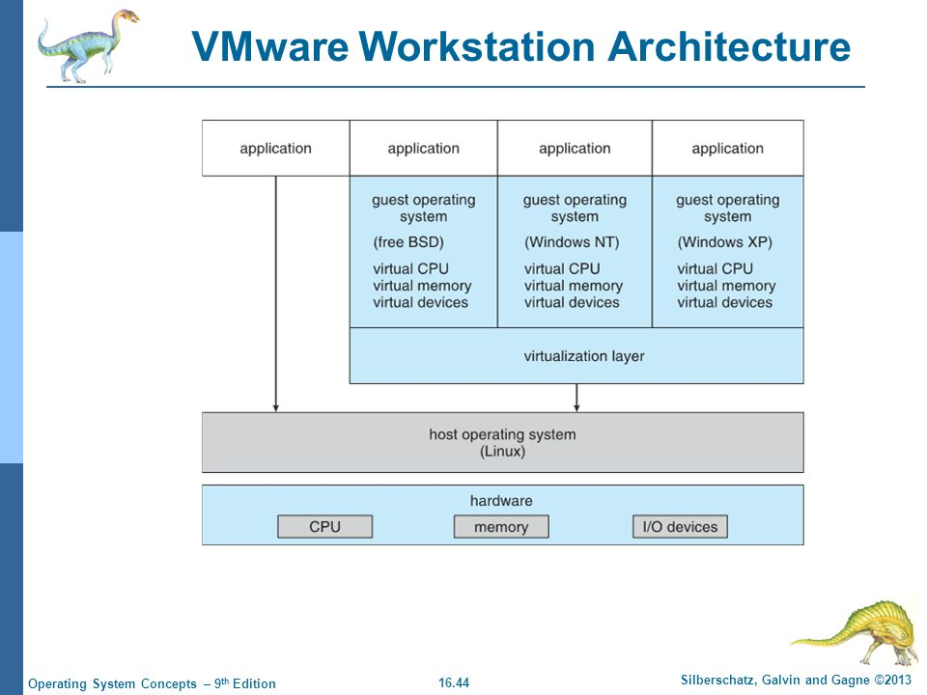
VIRTUAL MACHINES
Example of a Virtual Machine – VMWare.

Slide 60
UNIT -1
PROCESS MANAGEMENT

Slide 61
PROCESS CONCEPT
A process is a program in execution.
Program by itself is not a process
When a program is loaded into the memory
and it becomes a process, it can be divided into four sections ─ stack, heap, text and data.
Eg:a user may invoke several copies of same web browser program,where each copy is a process

Slide 62
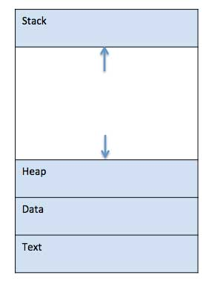
PROCESS CONCEPT
The following image shows a simplified layout of a process inside main memory −
Component & Description
Stack The process Stack contains the temporary data such as method/function parameters, return address and local variables.
Heap This is dynamically allocated memory to a process during its run time.
Data This section contains the global and static variables.
Text This includes the current activity represented by the value of Program Counter and the contents of the processor's registers.

Slide 63
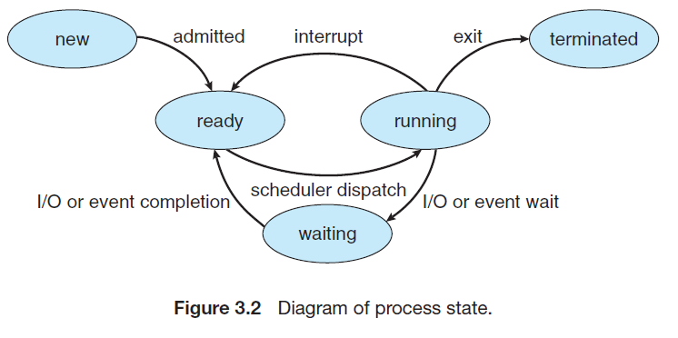
PROCESS STATES
When a process executes, it passes through different states.

Slide 64
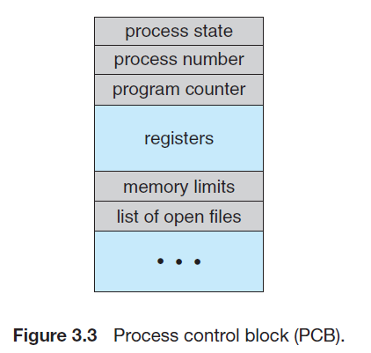
PROCESS CONTROL BLOCK
A Process Control Block is a data structure maintained by the Operating System for every process.

Slide 65
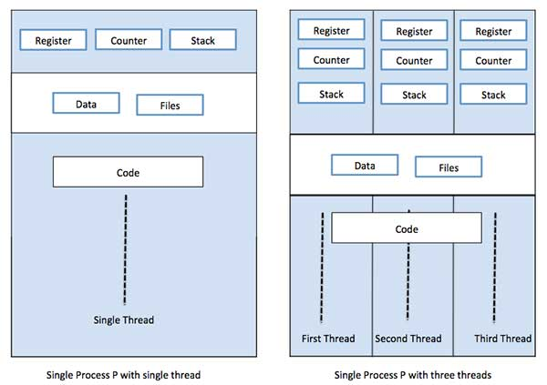
THREADS
A thread is a path of execution within a process. A process can contain multiple threads.
For example, in a browser, multiple tabs can be different threads.
Thread consists of thread id, program counter, register set and stack

Slide 66
THREADS
. For example, when a process is running a word-processor program,
a single thread of instructions is being executed.
This single thread of control allows the process to perform only one task at one time.
The user cannot simultaneously type in characters and run the spell checker within the same process,
Many modern operating systems have extended the process concept to allow a process to have multiple threads of execution and thus to perform more than one task at a time.

Slide 67
THREADS
Advantages of Thread over Process Responsiveness: If the process is divided into multiple threads, if one thread completes its execution, then its output can be immediately returned.
Effective utilization of multiprocessor system: If we have multiple threads in a single process, then we can schedule multiple threads on multiple processor. This will make process execution faster.

Slide 68
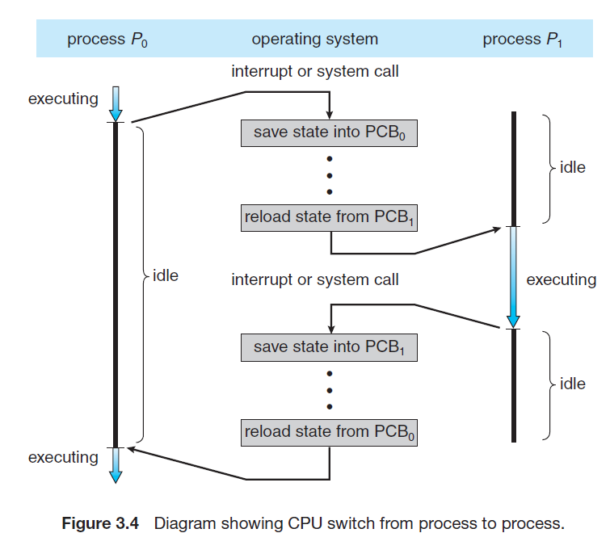
CONTEXT SWITCH

Slide 69
PROCESS SCHEDULING
The act of determining which process in the ready state should be moved to the running state is known as Process Scheduling.
The prime aim of the process scheduling system is to keep the CPU busy all the time and to deliver minimum response time for all programs
Schedulers fall into one of the two general categories:
Non pre-emptive scheduling :
Selected job runs to completion.
Once the CPU has been allotted a process, the process keeps the CPU until it terminates
Pre-emptive scheduling: When the operating system decides to favour another process, pre-empting the currently executing process.
The CPU can be taken away from process at any time.

Slide 70
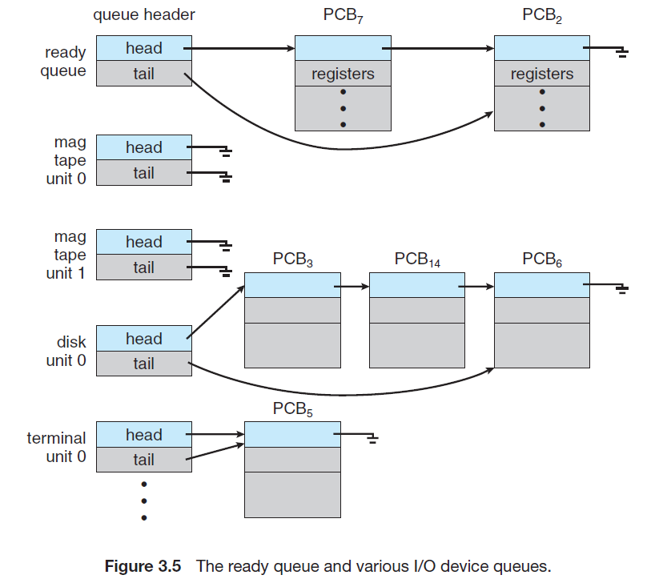
PROCESS SCHEDULING
Scheduling Queues :

Slide 71
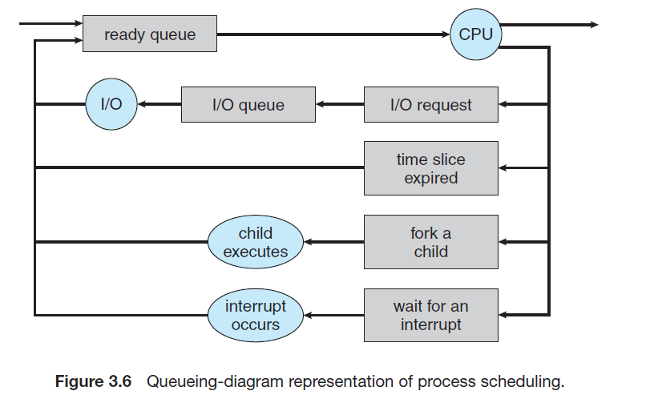
PROCESS SCHEDULING
Scheduling Queues : a common representation of scheduling

Slide 72
PROCESS SCHEDULING
Schedulers are special system software which handle process scheduling in various ways
Which selects the next job to be executed from queues
Schedulers Types:
Long – Term Scheduler
Short – Term Scheduler
Medium – Term Scheduler

Slide 73
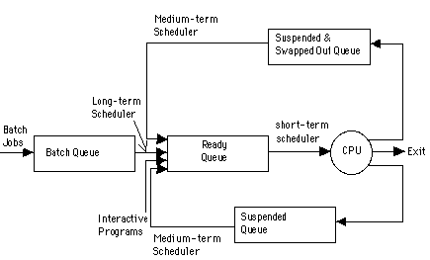

Slide 74
CPU SCHEDULER
Whenever the CPU becomes idle, the operating system must select one of the processes in the ready queue to be executed.
The selection process is carried out by the short-term scheduler (or CPU scheduler).

Slide 75
CPU SCHEDULER
Pre-emptive Scheduling
CPU-scheduling decisions may take place under the following four circumstances:
When a process switches from the running state to the waiting state (for example, as the result of an I/O request or an invocation of wait for the termination of one of the child processes)
When a process switches from the running state to the ready state (for example, when an interrupt occurs).
When a process terminates
When a process switches from the waiting state to the ready state (for example, at completion of I/O)

Slide 76
CPU SCHEDULER
The criteria include the following:
CPU utilization.
Throughput.
Turnaround time.
Waiting time.
Response time
Burst Time

Slide 77
1. CPU Utilization: The percentage of time the CPU is actively working on tasks, as opposed to being idle. A high CPU utilization indicates the system is effectively using its processor. The goal is to maximize CPU utilization without overloading it.
2. Throughput: The number of processes completed in a given amount of time. It measures how efficiently a system can process tasks. A higher throughput means the system can handle more work in less time.

Slide 78
3. Turnaround Time
The total time taken for a process to be executed from the moment it is submitted to the system until it is completed.
Formula: Turnaround Time=Completion Time−Arrival Time
Burst Time: Burst time refers to the total amount of time required by a process to execute on the CPU. It is the actual CPU time needed by the process to complete its execution, excluding any waiting time or I/O time.
Example: Suppose a process requires 10 milliseconds of CPU time to finish. Its burst time is 10 ms.
4. Waiting Time
The amount of time a process spends in the ready queue waiting for the CPU to execute it. It excludes the time the process is executing or performing I/O operations.
Formula: Waiting Time=Turnaround Time−Burst Time

Slide 79
5. Response Time
The time from when a request is submitted until the first response is produced (not the completion of the process). This is particularly important for interactive systems where quick responses improve user experience.
Types of Burst Time
CPU Burst: The amount of time the process spends executing instructions on the CPU.
I/O Burst: The time the process spends performing I/O operations, such as reading or writing to a file.

Slide 80
SCHEDULING ALGORITHMS
CPU scheduling deals with the problem of deciding which of the processes in the ready queue is to be allocated the CPU.
First-Come, First-Served Scheduling
Shortest-Job-First Scheduling
Priority Scheduling
Round robin algorithm

Slide 81
SCHEDULING ALGORITHMS
These algorithms are either non-preemptive or preemptive.
Non-preemptive algorithms are designed so that once a process enters the running state, it cannot be preempted until it completes its allotted time,
whereas the preemptive scheduling is based on priority where a scheduler may preempt a low priority running process anytime when a high priority process enters into a ready state.

Slide 82
SCHEDULING ALGORITHMS
First-Come, First-Served Scheduling
Jobs are executed on first come, first serve basis. It is a nonpreemptive scheduling algorithm.
Easy to understand and implement.
Its implementation is based on FIFO queue.
Poor in performance as average wait time is high.

Slide 83
SCHEDULING ALGORITHMS
First-Come, First-Served Scheduling
The simplest CPU-scheduling algorithm is the first-come, first-served (FCFS) scheduling algorithm.
With this scheme, the process that requests the CPU first is allocated the CPU first.
The implementation of the FCFS policy is easily managed with a FIFO queue.
When a process enters the ready queue, its PCB is linked onto the tail of the queue.
When the CPU is free, it is allocated to the process at the head of the queue.
p3
p2
p1
cpu
Completed job

Slide 84
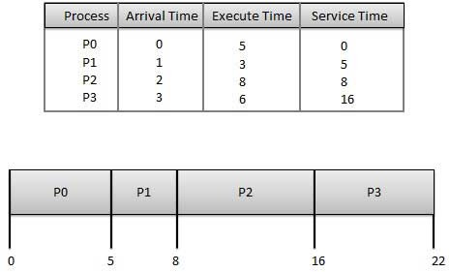
SCHEDULING ALGORITHMS

Slide 85
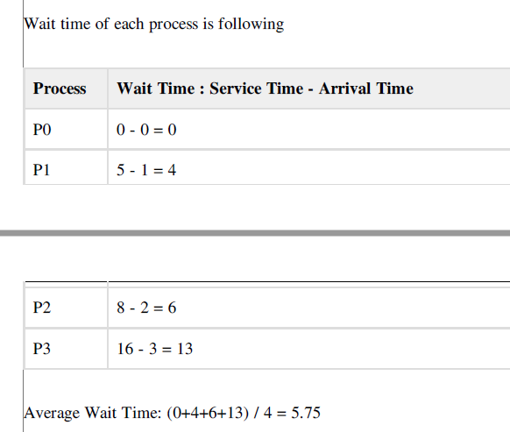
SCHEDULING ALGORITHMS

Slide 86
SCHEDULING ALGORITHMS
Shortest Job Next (SJN)
This is also known as shortest job first, or SJF
This is a nonpreemptive scheduling algorithm.
Best approach to minimize waiting time.
Easy to implement in Batch systems where required CPU time is known in advance.
Impossible to implement in interactive systems where required CPU time is not known.
Processer should know in advance how much time process will take.

Slide 87
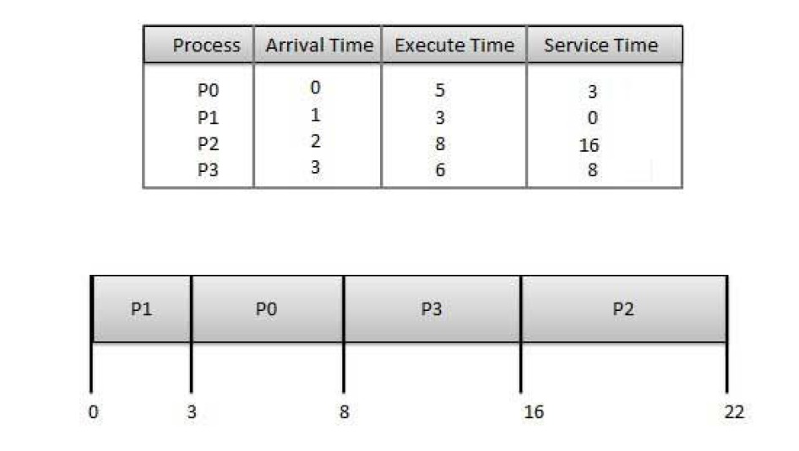
SCHEDULING ALGORITHMS

Slide 88
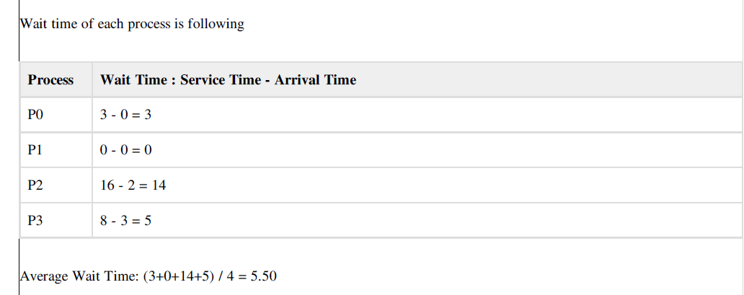
SCHEDULING ALGORITHMS

Slide 89
SCHEDULING ALGORITHMS
Priority Based Scheduling
Priority scheduling is a nonpreemptive algorithm and one of the most common scheduling algorithms in batch systems.
Each process is assigned a priority. Process with highest priority is to be executed first and so on.
Processes with same priority are executed on first come first serve basis.
Priority can be decided based on memory requirements, time requirements or any other resource requirement.

Slide 90
SCHEDULING ALGORITHMS

Slide 91
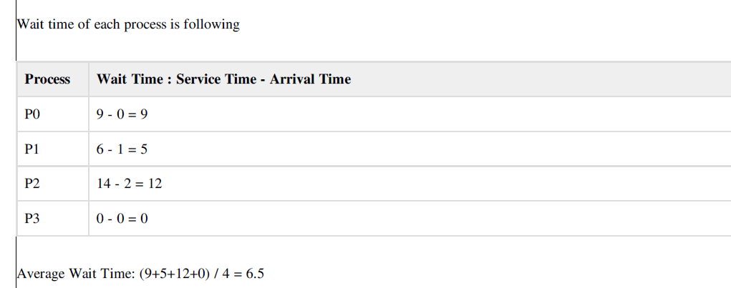
SCHEDULING ALGORITHMS

Slide 92
SCHEDULING ALGORITHMS
Round Robin Scheduling
Round Robin is the preemptive process scheduling algorithm.
Each process is provided a fix time to execute called quantum.
Once a process is executed for given time period.
Process is preempted and other process executes for given time period.
Context switching is used to save states of preempted processes.

Slide 93
SCHEDULING ALGORITHMS

Slide 94
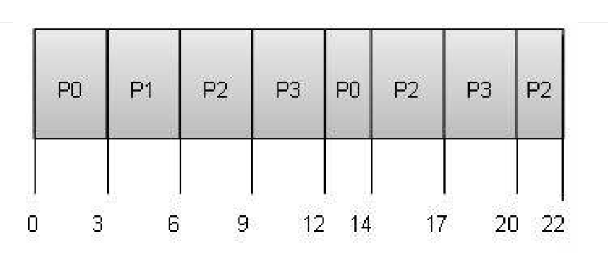
SCHEDULING ALGORITHMS

Slide 95
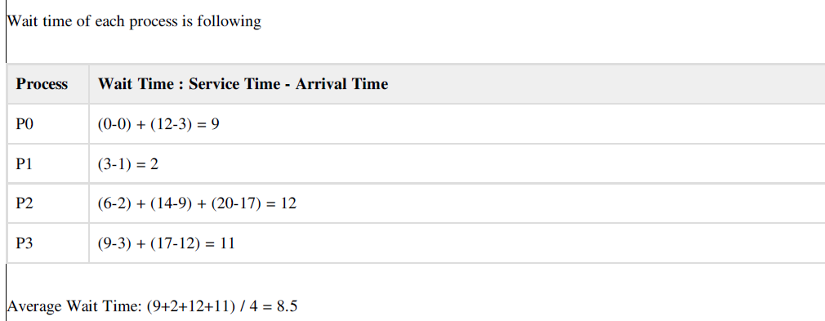
SCHEDULING ALGORITHMS

Slide 96
PROCESS SYNCHRONIZATION
Process Synchronization means sharing system resources by processes in a way that, Concurrent access to shared data is handled thereby minimizing the chance of inconsistent data.
Maintaining data consistency demands mechanisms to ensure synchronized execution of cooperating processes.

Slide 97
THE CRITICAL SECTION PROBLEM
A Critical Section is a code segment that accesses shared variables and has to be executed as an atomic action.
It means that in a group of cooperating processes, at a given point of time, only one process must be executing its critical section. If any other process also wants to execute its critical section, it must wait until the first one finishes.

Slide 98
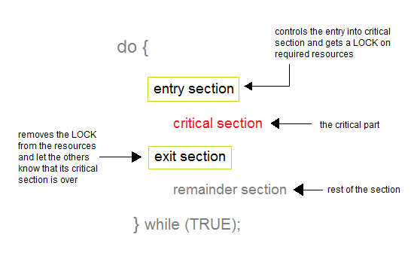
THE CRITICAL SECTION PROBLEM
General Structure of a typical process

Slide 99
THE CRITICAL SECTION PROBLEM
Solution to Critical Section Problem
Mutual Exclusion
Progress
Bounded Waiting

Slide 100
SEMAPHORES
A semaphore, in its most basic form, is a protected integer variable that can facilitate and restrict access to shared resources in a multi-processing environment.
The two most common kinds of semaphores are
1) Counting semaphores and
2) Binary semaphores.

Slide 101
SEMAPHORES
Counting semaphores represent multiple resources.
Binary semaphores represents two possible states (generally 0 or 1; locked or unlocked).
Semaphores were invented by the late Edsger Dijkstra.
Semaphores can be looked at as a representation of a limited number of resources, like seating capacity at a restaurant.

Slide 102
SEMAPHORES
A semaphore can only be accessed using the following operations:
1. wait() and
2. signal().
wait() is called when a process wants access to a resource.
signal() is called when a process is done using a resource.

Slide 103
SEMAPHORES
The following is an implementation of this counting semaphore (where the value can be greater than 1):
wait(Semaphore s) {
while (s==0);
/* wait until s>0 */
s=s-1;
}
signal(Semaphore s)
{
s=s+1;
}

Slide 104
SEMAPHORES
Properties of Semaphores
Simple
Works with many processes
Can have many different critical sections with different semaphores
Each critical section has unique access semaphores
Can permit multiple processes into the critical section at once, if desirable.

Slide 105
SEMAPHORES
Limitations of Semaphores
Priority Inversion is a big limitation os semaphores.
Their use is not enforced, but is by convention only.
With improper use, a process may block indefinitely. Such a situation is called Deadlock.

Slide 106
CLASSIC PROBLEMS OF SYNCHRONIZATION
CLASSIC PROBLEMS OF SYNCHRONIZATION
Following are some of the classical problem faced while process synchronization in systems where cooperating processes are present.
1. The Bounded-Buffer problem
2. The Reader’s-Writer’s problem
3. The Dining-Philosophers Problem.

Slide 107
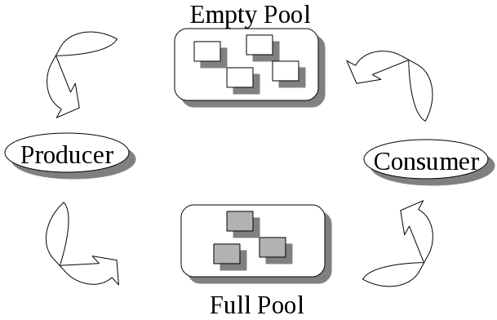
CLASSIC PROBLEMS OF SYNCHRONIZATION
Figure: The Bounded Buffer Problem

Slide 108
REFERENCES
Operating Systems, ABRAHAM SILBERSCHATZ, PETER BAER GALVIN, GREGGAGNE, 7th Edition.
http://www.studytonight.com/operating-system/process-synchronization
https://www.cs.uic.edu/~jbell/CourseNotes/OperatingSystems/5_Synchronization.html
https://www.cs.mtu.edu/~shene/NSF-3/e-Book/SEMA/TM-example-buffer.html
https://en.wikibooks.org/wiki/Operating_System_Design/Processes/Semaphores
http://www.studytonight.com/operating-system/deadlocks
http://faculty.salina.k-state.edu/tim/ossg/IPC_sync/bounded_buffer.html

